Slide 1

Green Chemistry and Engineering platform for innovation in chemical products and processes
Rene VAN BERKEL
Chief, Cleaner and Sustainable Production Unit
United Nations Industrial Development Organization
Vienna, Austria
Notes:
1

Slide 2
Developments in Chemicals Management
STRATEGY
Innovation
New Business Models (ChL)
Efficiency
Control
New Management Frameworks
(SAICM, REACH, etc.)
Chemicals Management
AIMS
Occupational Health & Safety
Community & Consumer Safety
Environmental Protection
Sustainable Development

Slide 3
Developments in Chemicals Management
STRATEGY
Biomimicry
Innovation
Green Chemistry
Green Engineering
Efficiency
Control
Chemicals Management
AIMS
Occupational Health & Safety
Community & Consumer Safety
Environmental Protection
Sustainable Development

Slide 4
Green Chemistry and Engineering
Green Engineering
Aims to achieve sustainability through the application of science and technology in engineering design leading to efficient, safe and environmentally compatible industrial plants
Green Chemistry
Design, development and implementation of chemical products and processes to reduce or eliminate the use and generation of hazardous substances
Development of Green Engineering and Green Chemistry is driven by parallel sets of 12 normative sustainability principles,
which could be interpreted as high level design heuristics
Van Berkel et al (2005), Eco-Efficiency for Design and Operation of Minerals Processing Plants, Proceedings Chemeca 2005, Brisbane, Australia

Slide 5

Anastas P. (1998), Green Chemistry: theory and practice, Oxford University Press, Oxford UK

Slide 6
Design Heuristics
Green Chemistry | Green Engineering
Design for Waste Prevention | Design for Inherently Non-Hazardous Material and Energy Inputs and Outputs
Design for Atom Efficiency | Design for Waste Prevention
Design for Less Hazardous Chemical Synthesis | Design for Separation
Design of Safer Chemicals | Design for Maximum Energy, Space and Time Efficiency
Design for Safer Solvents and Auxiliaries | Design for “Output-Pulled” versus “Input-Pushed”
Design for Energy Efficiency | Design for Conservation of Complexity
Design for Use of Renewable Feedstocks | Design for Durability Not Immortality
Design to Reduce Derivatives | Design to Meet Need and Minimise Excess
Design for Catalysis | Design for Minimal Material Diversity
Design for Product Degradation | Design for Process Integration
Design for Real Time Analysis and Control for Pollution Prevention | Design for Performance in a Commercial After Life
Design for Inherently Safer Chemistry | Design for Renewable Material and Energy Inputs
Van Berkel (2005), Eco-Efficiency for Design and Operation of Minerals Processing Plants, Proceedings Chemeca 2005

Slide 7
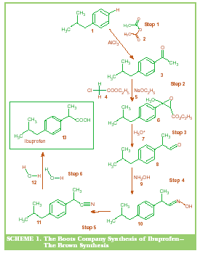
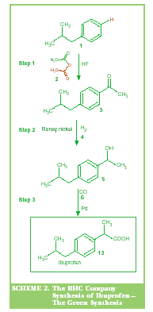
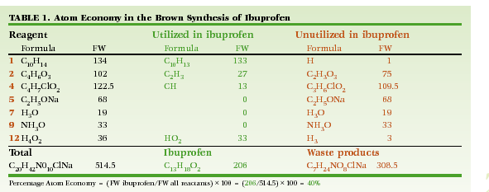
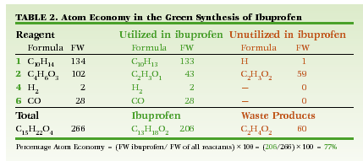
Atom Efficiency Illustrated
Atom efficiency increased from 40 to 77%
Reaction level process waste reduced from 148 to 29%
(i.e. by 80%)
Industrial success story
1997 Winner Presidential Green Chemistry Award
Developed and commercialized by BHC, now BASF
Cann, M et al (2000), Real World Cases in Green Chemistry, American Chemical Society, Washington DC

Slide 8
Novel Solvents: Supercritical CO₂
Supercritical carbon dioxide exhibits properties which are intermediate between those of gases and liquids, which make it ideal as a solvent that can easily be ‘vented off’ without evaporation or distillation and without leaving residues
The supercritical conditions are readily achievable (>31.6ºC, >73 atmosphere)
Now increasingly being used on commercial scale for
Extraction and purification of speciality chemicals and useful natural products (pharmaceuticals, caffeine etc.)
Alternative solvent in coatings industry
Degreasing and dry-cleaning
Solvent for synthetic industrial processes

Slide 9
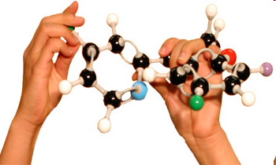
New Reactions: Catalysis
Catalysts increase reaction yield and specificity and reduce its energy requirement and waste generation
Nano-technology provides new possibility to design and construct effective catalysts
For example: Fisher Tops synthesis of liquid fuels from synthesis gas produced from biomass
Bio-catalysis is based on use of enzymes to catalyse reactions
For example: cellulase enzymes to break down woody biomass as source for bio-ethanol production

Slide 10
Novel Reactors: Microwaves
Microwave Technology
Modern microwave equipment allows precise and safe control of power both in batch and continuous reactions. It enables more energy efficient heating as well as faster and cleaner chemical reactions.
Microwaves also promote novel reaction pathways and can greatly accelerate reaction rates as a result of specific interactions.
Applications
Selective production and/or extraction of valuable chemicals from biomass prior to use of bulk for bio-fuel
Widespread use in chemical discovery in pharmaceutical and related industries

Slide 11
Hydrogen Peroxide to Propylene Oxide (HPPO)
Innovative process for production of P0
PO is top 30 chemical intermediate – used in variety of applications
Traditional process uses organic peroxides and produces organic byproducts, requiring disposal or recycling
New process uses hydrogen peroxide and produces water as byproduct
High selectivity and efficiency
25% lower capital expenditure – no waste treatment facility required
70-80 reduction of waste water
35% reduction of energy
Developed and commercialized by Dow-BASF
First commercial plant in 2008 in Belgium
Second commercial plant in 2011 in Thailand
Industrial success story
2010 Winner Presidential Green Chemistry Award

Slide 12
Process Intensification
Is a engineering design strategy to adapt the process to the chemical reaction
Doing More With Less
Adapting size of equipment to the reaction
Replacing large, expensive and inefficient equipment by smaller, more efficient and cheaper equipment
Choosing the technology that best suits each process step
Sometimes combining multiple operations in fewer aparatuses
Multiple benefits:
Better resource productivity and environmental performance
Smaller, more versatile plants with lower costs
Safer plants

Slide 13
Eco-Efficient Plant Design
Alcoa Pinjarra Alumina Refinery Upgrade
Additional capacity of 600 ktpa to 4.2 Mtpa – no absolute increase in GHG emissions
Process and Utility Flow-sheet
Maximising energy recovery, e.g. from digestion to causticiser
Novel Unit Operations
Seed precipitation to enhance precipitation
Energy efficient new calciner (~ 5%)
Regenerative Thermal Oxidisers (2*)
Engineering Design
Enhancements in pumping and process controls
Re-engineering of bauxite mill
Industrial success story
Van Berkel (2005), Eco-Efficiency for Design and Operation of Minerals Processing Plants, Proceedings Chemeca 2005

Slide 14

Biomimicry
Innovation Inspired by Nature
Biomimicry or biomimetics is the examination of nature, its models, systems, processes, and elements to emulate or take inspiration from in order to solve human problems.
14

Slide 15
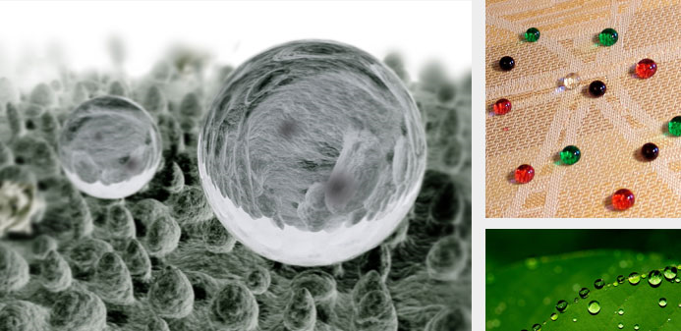
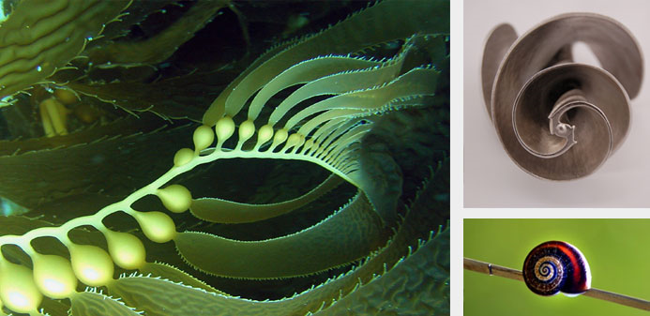
Biomimicry
The lotus has a microscopically rough leaf surface that causes moisture to roll off taking attached dirt particles with it. Now microscopi- cally rough additives are added to new gene- ration paint, glass and fabric finishes, greatly reducing the need for chemical or laborious cleaning.
e.g. www.stocorp.com
Nature moves water and air using a logarithmic or exponentially growing spiral as seen in a seashell. Applying this fundamental geometry to the design of human-made rotors, reduces energy consumption by 10-85% and noise by up to 75%, in fans, mixers, pumps, turbines.
e.g. www.paxscientific.com
www.biomimicryinstitute.org

Slide 16
Concluding Remark
Green Chemistry and Engineering
Proven sustainable industrial development and innovation strategy
The desirable, but not exclusive, aim for innovation in chemical industry
Important avenue for greening of industry and creating new green industries
Complementary nature
Green Industry Solutions
Control
+
Efficiency
+
Innovation
=

Slide 17
Near Term Possibilities for RECPnet
Bio-plastics and bio-ethanol
Starting from waste agricultural biomass
Supercritical Extraction with CO₂
Extraction of active ingredients (pharma, dyes, etc) from plant materials
Enzyme-technology
Widespread opportunities for example in textile processing industry

Slide 18


Thank You
René VAN BERKEL
Chief, Cleaner and Sustainable Production Unit
r.vanberkel(at)unido.org
www.unido.org/cp

